Slide 1
Digital Media Technology Conclusion
Peter Verhaar

Slide 2
Properties of digital models
Ontologies: DTD and ERD
Data formats: XML or relational databases
Manipulations: XSLT and SQL

Slide 3
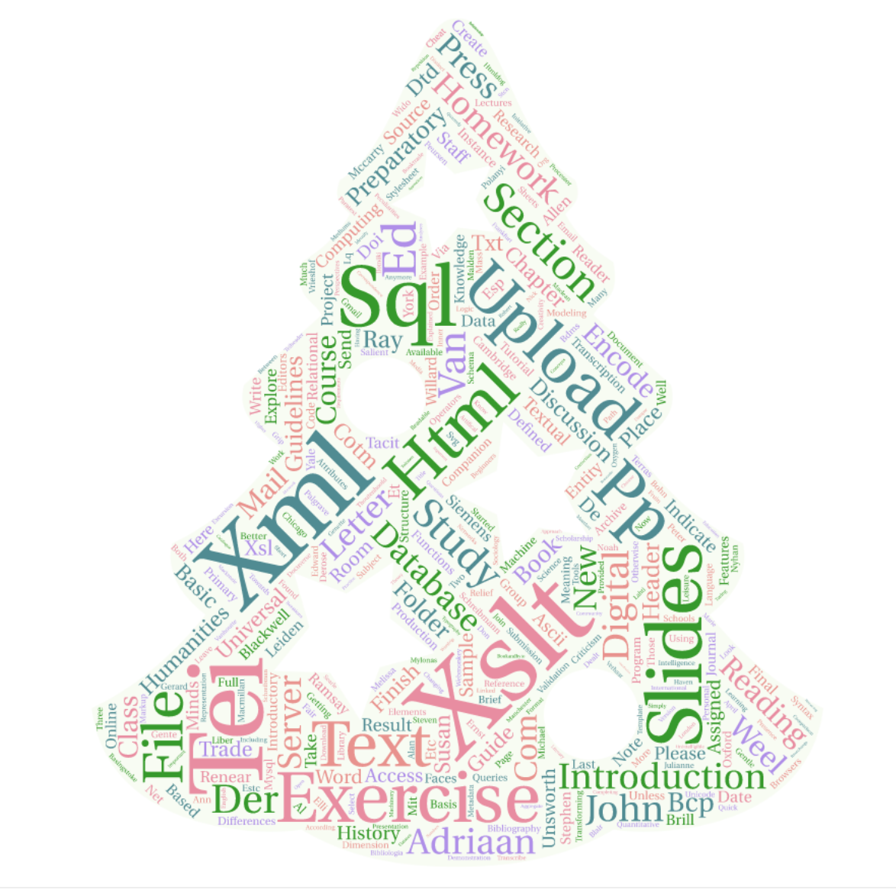

Slide 4
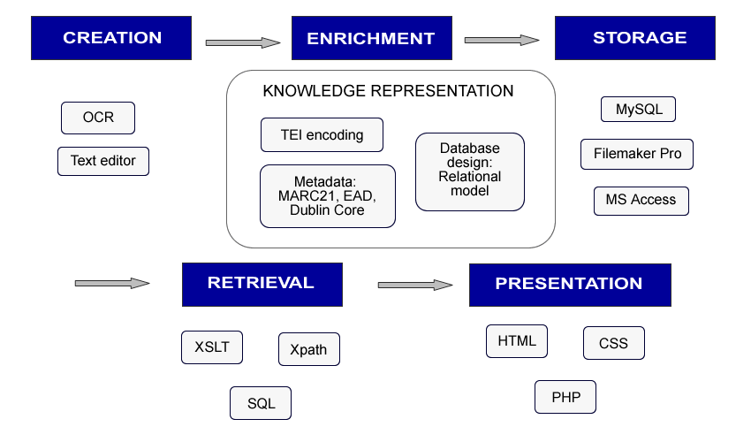
Lifecycle of digital objects

Slide 5
Computational Thinking
Selection and iteration
Conditions based on Boolean expressions
Syntactical requirements
Possibilities and limitations of algorithms

Slide 6
Data and tool criticism
Data, algorithms and tools are based on assumptions which can often be questioned
XML, of instance, is based on the assumption that the components that make up a text follow a hierarchical structure
Technologies used in digital humanities have typically been adopted from other field

Slide 7
Digital Access to Cultural Heritage
Focus on the state of art of digitisation projects within the broader cultural heritage sector
No practical experience with technologies, but a focus on organisational aspects and on the ways in which technologies are implemented
Organised in collaboration with KB

Slide 8
DACH Programme
Basic digitisation technologies and metadata standards
Portals and aggregation (e.g. Europeana)
Web interfaces and useability
Reuse of scans and of metadata (IIIF, APIs, LOD)
Intellectual property and licences
Applications in digital humanities

Slide 9
Digital Text and Data Processing
Relatively new specialisation
Distant reading; quantitative analyses of literature
Text and Data Mining and programming in Python
No prior knowledge is needed

Slide 10
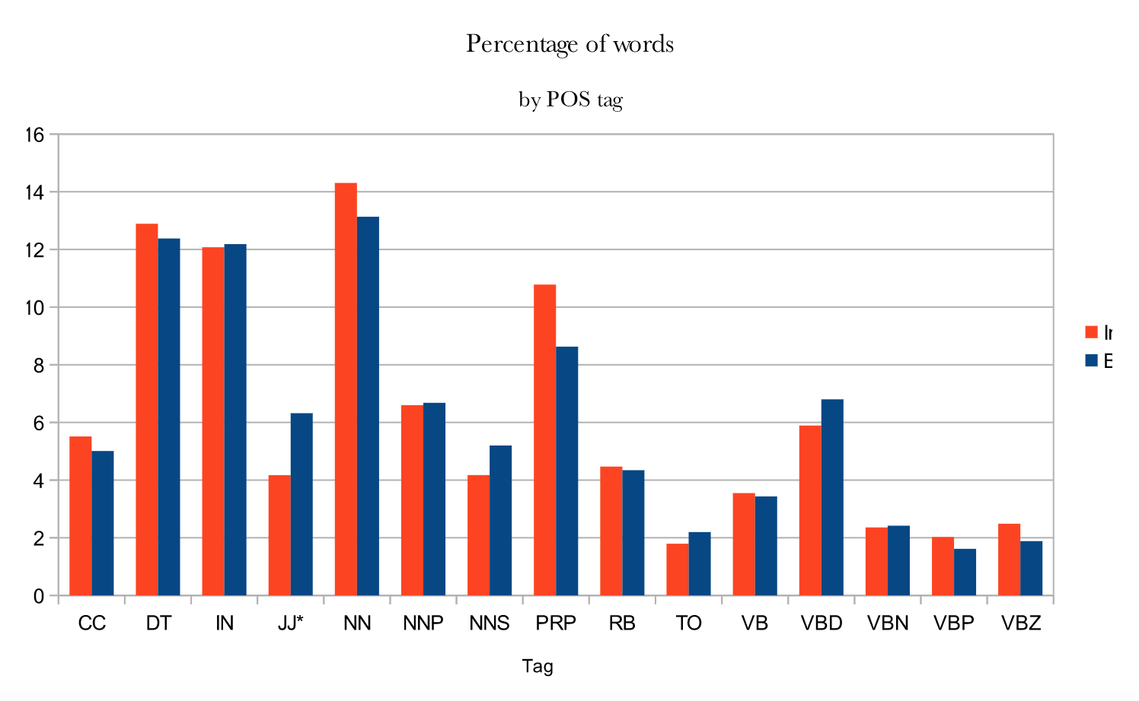
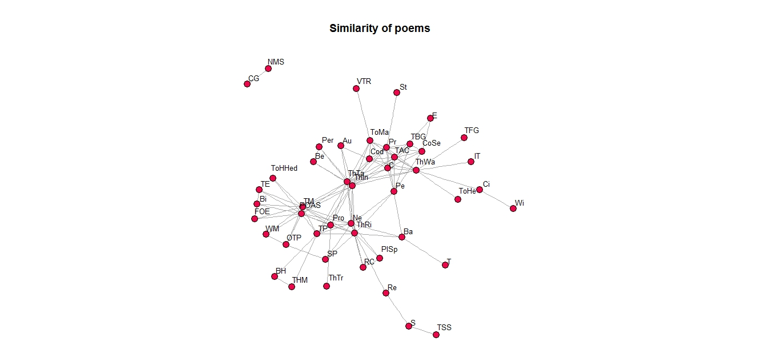
Individual research projects

Slide 11
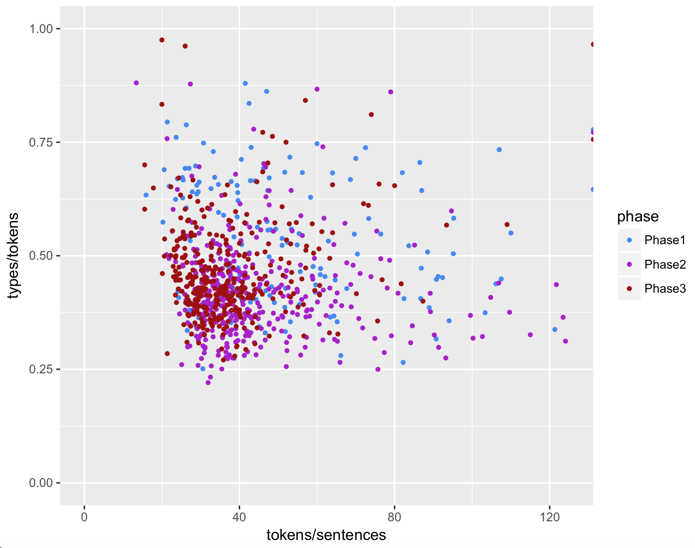
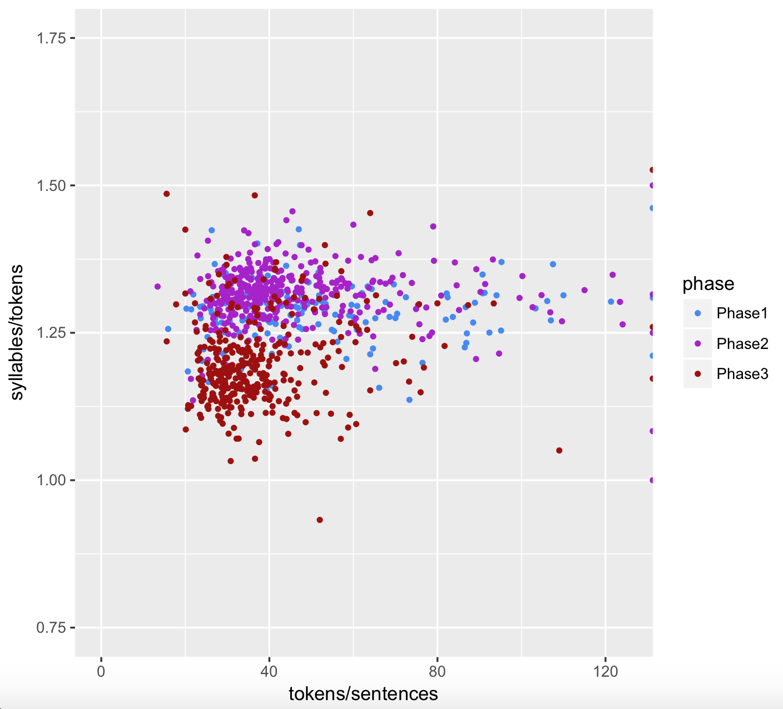
Correspondence of Van Gogh

Slide 12
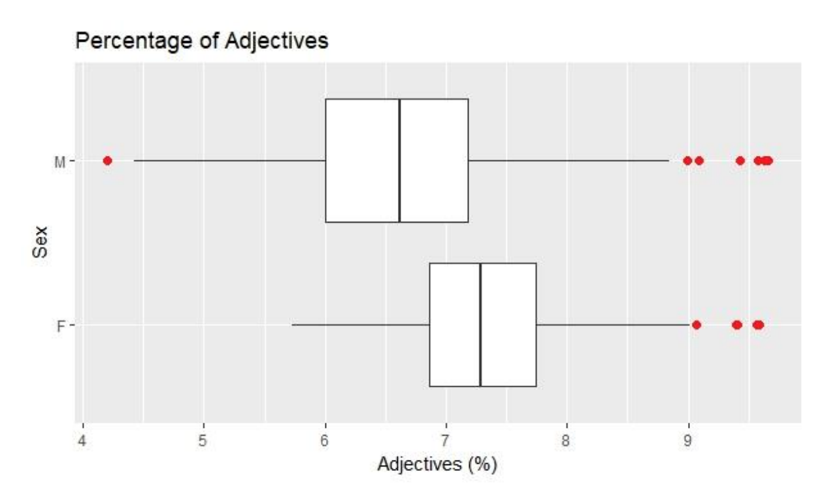
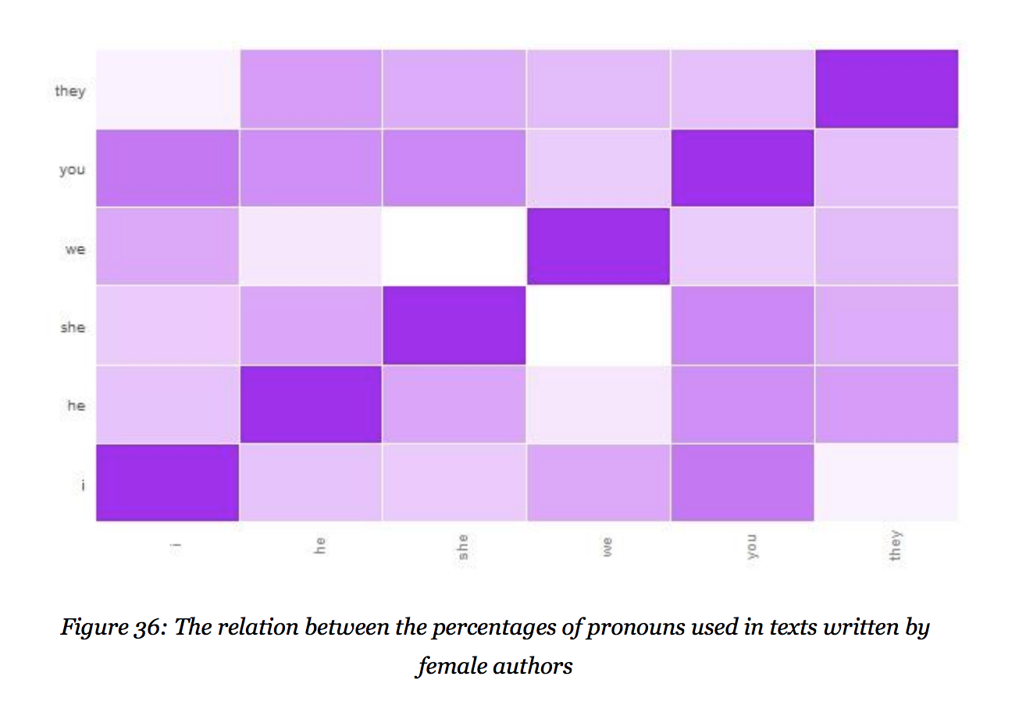
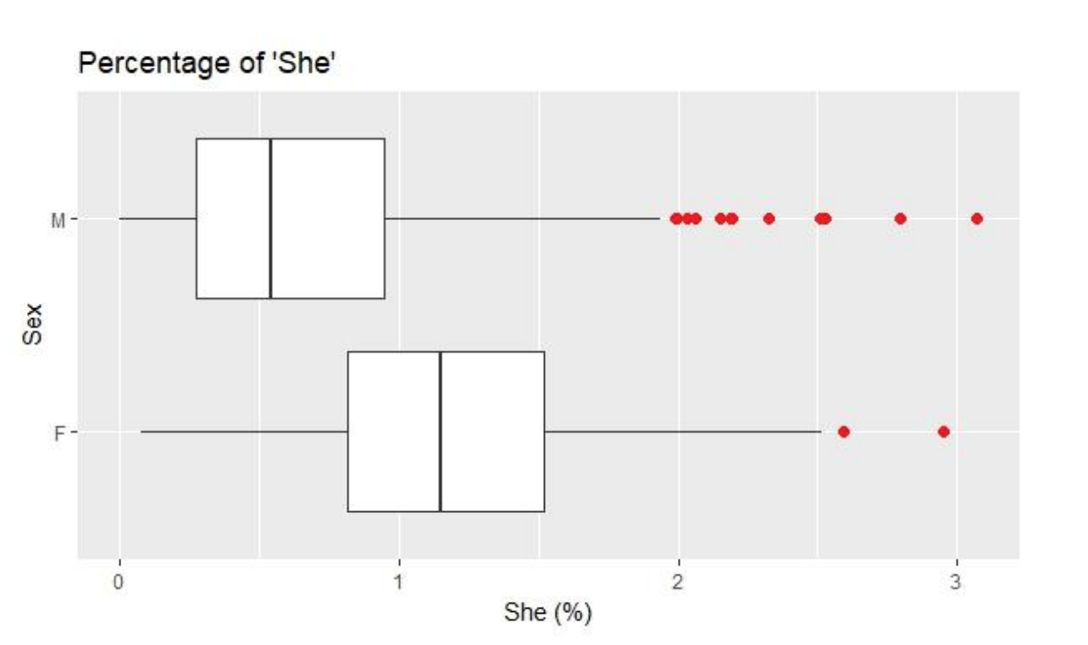
Male and female writing styles

Slide 13
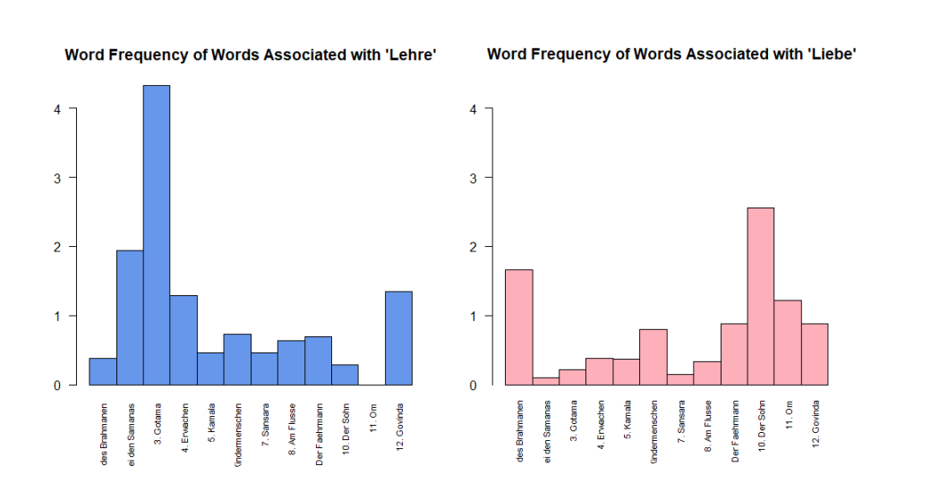
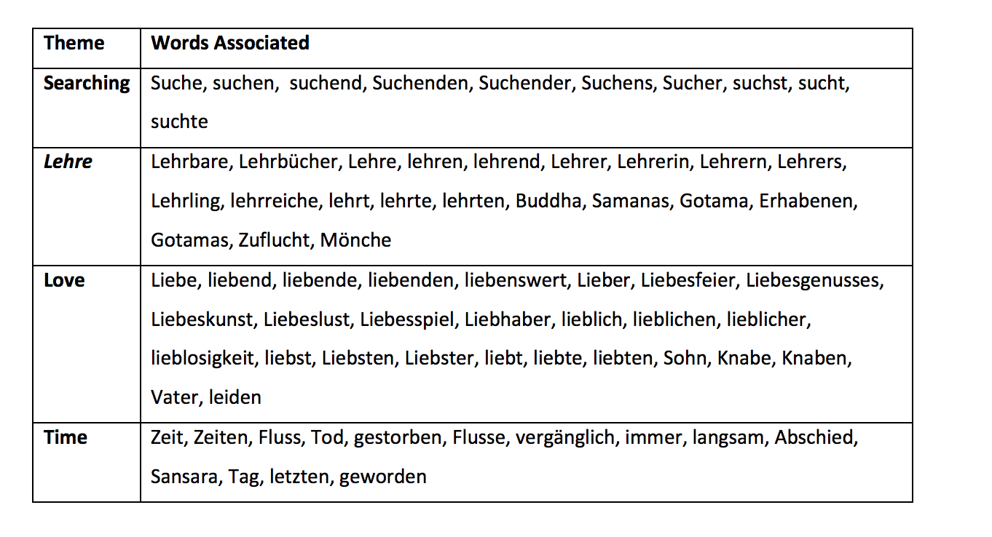
Microanalysis of Siddhartha

Slide 14
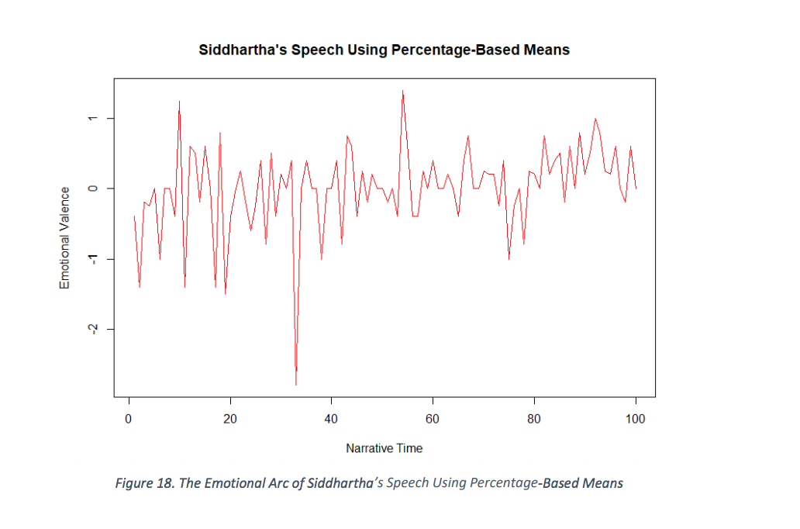
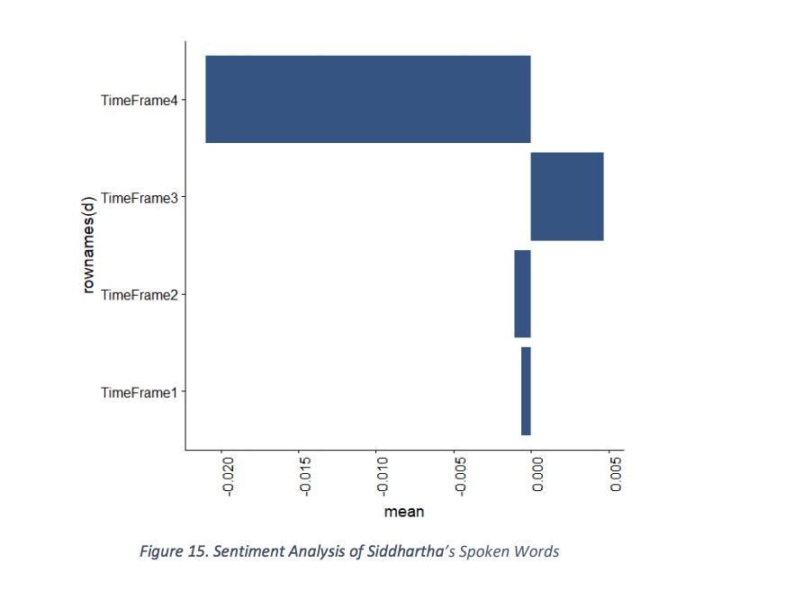
Sentiment Analysis

Slide 15
Tools Criticism
Cultural, political and societal implications of digital humanities tools
Can building a tool be considered a scholarly or a theoretical activity?
Can tools be subjected to peer review?
Tools always make a scholarly statement

Slide 16
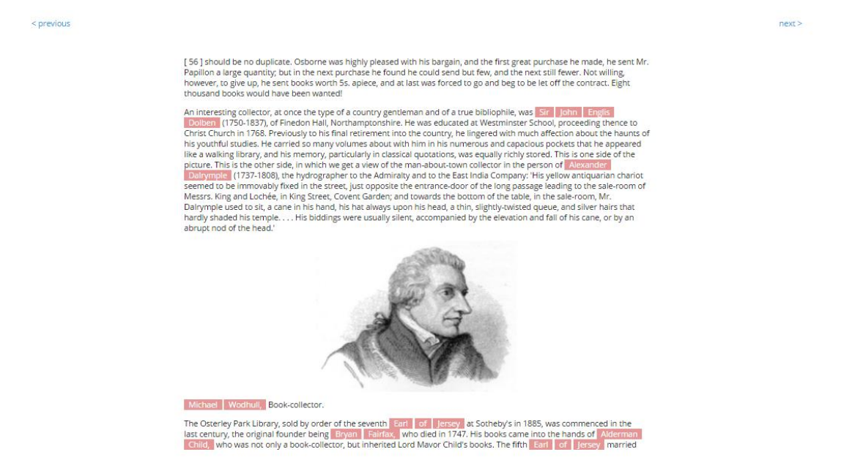
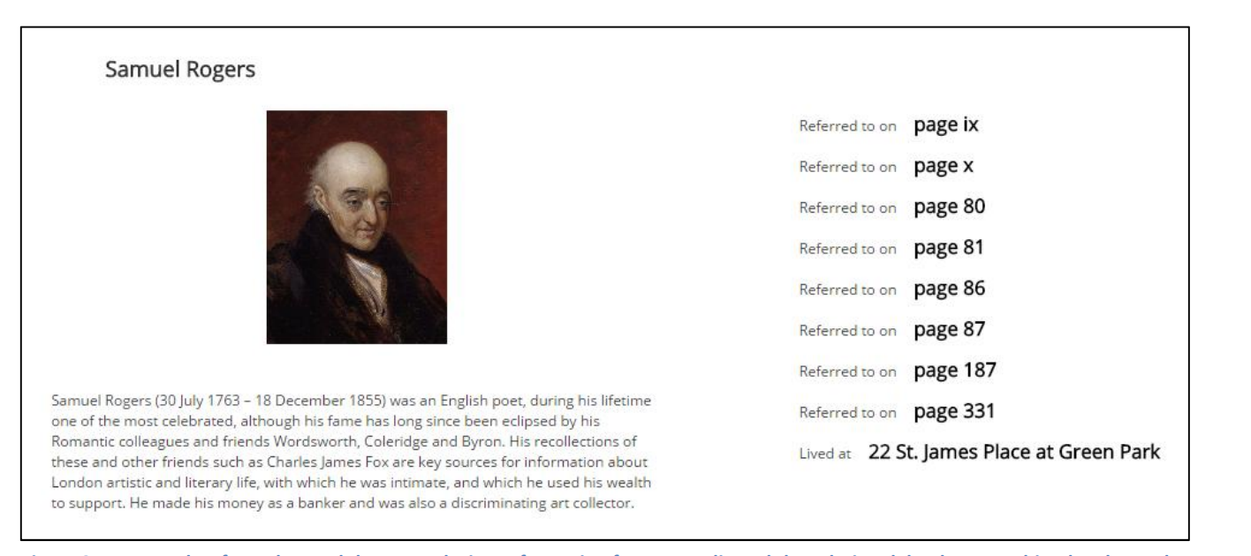
Semantic publishing

Slide 17
</dmt>

